Slide 1

PASSPORT DATABASE
Made By:
Amit Vaidya
Areeb Yahya
Aprajita Sahai
Akriti Sharma
Abhinav Prateek

Slide 2
Introduction
A passport is a travel document, usually issued by the government of a nation, that certifies the identity and nationality of its holder for the purpose of international travel.
Passport database includes all the details of the applicants, The passport seva kendra keeps track of all the employees working under it and issues the passport after verifying the documents.
The passport contains all the details of the applicant.

Slide 3
Requirements
Applicant Details Entity:
App no is number and should not be null.It is the primary key.
Fname and Lname are the name of the applicant of type string. It cannot be null.
Date of Birth(DOB) is of type date(DD-MM-YYYY).
Address is a composite attribute which further contain 4 attributes-House no,Street,City,Pin.
Passport Seva Kendra(PSK) Entity:
PSK serves as the middle man betweeen the applicant and the passport office.
It recieves the application and verifyies various document.On proper verfication,it forwards the application and passport is made.
Each PSK is given a unique PSKID,which is the primary key.
PSK have man employee who verifies the application.
Each employee is given a unique id,called EID.
Passport Entity:
It contains the passport details that is issued by a PSK.
Passport_no (Pno) is the primary key which is of type integer.
The passport is issued from the city which is same as the city of PSK.

Slide 4
TABLE DETAILS
APPLICANT
PSK
PASSPORT
COLUMN NAME | DATA TYPE
APP_NO | NUMBER
FNAME | VARCHAR2
LANAME | VARCAHR2
FATHER_NAME | VARCHAR2
MOTHER_NAME | VARCAHE2
CONTACT_NO | NUMBER
GENDER | VARCAHR2
DOB | DATE
AADHAR_NO | VARCAHR2
HOUSE_NO | NUMBER
STREET | VARCHAR2
CITY | VARCHAR2
PIN | NUMBER
COLUMN NAME | DATA TYPE
EID | NUMBER
ENAME | VARCAHR2
PSKID | NUMBER
CITY | VARCHAR2
APP_NO | NUMBER
COLUMN NAME | DATA TYPE
PASSPORT_NO | NUMBER
APP_NO | NUMBER
FNAME | VARCHAR2
LANAME | VARCAHR2
FATHER_NAME | VARCHAR2
PLACE_OF_ISSUE | VARCHAR2
VALID_FROM | NUMBER
VALID_TILL | NUMBER
ADDRESS | VARCAHR2

Slide 5
Schema
APPLICANT DETAIL
App_no
Fname
Lname
Dob
Gender
Contact_no
Father_name
Mother_name
House_no
Street
City
Pin
PASSPORT SEVA KENDRA
Eid
Ename
Psk_id
City
App_no
PASSPORT
Fname Lname App_no Dob Place_of_issue Valid_from Valid_till Address Pn0

Slide 6

ER Diagram
App_no
Lname
Fname
Contact_no
Eid
Ename
Dob
M
N
Aadhar_no
APPLICANT DETAIL
Verified by
PASSPORT SEVA KENDRA
M
Mother_name
Father_name
Address
Gender
City
Psk_id
Issues
House_no
Street
City
Pin
N
Fname
App_no
Dob
Lname
Place_of_issue
PASSPORT
Pno
Valid_from
Valid_till

Slide 7
Backend
The backend is made using Oracle Database 10g DBMS and is accessed by the web browser using the Oracle Net Services.

Slide 8
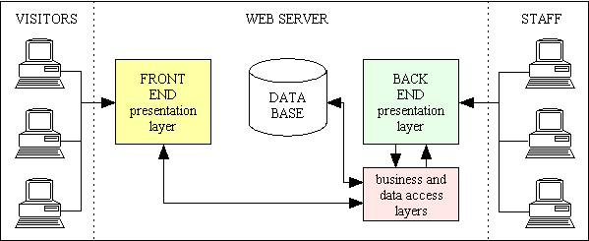
Fig. Frontend Backend Connectivity

Slide 9
FrontEnd Connectivity
Frontend is made using the application builder of Oracle database 10g.
It is a rapid develpoment tool that creates applications directly based on table in the database.
It is connected to database using PL/SQL constructs as the base server-side language

Slide 10
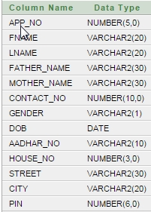
Creating Table
APPLICANT TABLE
create table applicant(app_no number(5) primary key,fname varchar2(20) not null,lname varchar2(20) not null,father_name varchar2(30) not null,mother_name varchar2(30) not null,contact_no number(10) not null,gender varchar2(1) not null,dob date not null,aadhar_no varchar2(10) not null,house_no number(3),street varchar2(30) not null,city varchar2(20) not null,pin number(6) not null);

Slide 11
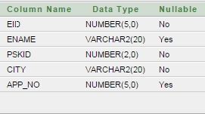
Creating Table
PSK TABLE
create table psk(eid number(5) primary key,ename varchar2(20),pskid number(2) not null,city varchar2(20) not null,app_no number(5),foreign key(app_no) references applicant(app_no));

Slide 12
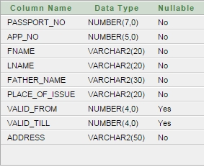
Creating Table
PASSPORT TABLE
create table passport(app_no number(5) not null,fname varchar2(20) not null,lname varchar2(20) not null,father_name varchar2(30) not null,place_of_issue varchar2(20) not null,valid_from number(4),valid_till number(4),passport_no number(7) primary key,address varchar2(50) not null,foreign key(place_of_issue) references psk(city))

Slide 13
Inserting into Table

Slide 14
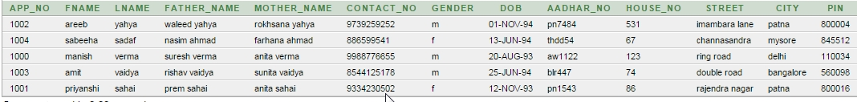
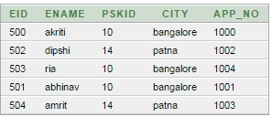
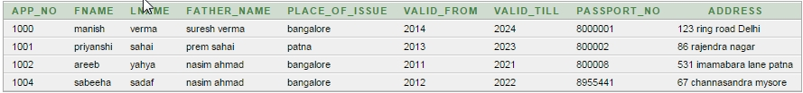
Sample Tables
APPLICANT TABLE
PSK TABLE
PASSPORT TABLE

Slide 15

QUERIES
List the passport_no,fname,lname of passport issued from Bangalore PSK.
select passport_no,fname,lname from passport
where place_of_issue=‘bangalore’;

Slide 16

QUERIES
List all the passport fname,lname,passport_no who are resident of ‘mysore’ and the passport is issued from ‘bangalore ‘ PSK.
List out the name and passport_no of passport which are valid till 2023.
select passport_no,fname,lname,valid_till from passport
where valid_till<=2023

Slide 17


